Slide 1
VIDEO GAME SALES PREDICTION
ABHISHEK PRASAD

Slide 2
Video Game Sales (Aim)
Predicting video game sales can be a complex task, as it depends on various factors such as the game's genre, platform, marketing efforts, reviews, and more. To make an accurate prediction on many data tasks .
Data Collection :- Gather historical data on video game sales. This data should include information about the game's release date, platform, genre, publisher, critic and user reviews, marketing budget, and sales figures
Data Cleaning and Preprocessing :- a) Clean the data by handling missing values, outliers, and inconsistencies. b) Convert categorical data (e.g., genre, platform) into numerical format using techniques.
Feature Selection :- Identify which features (attributes) are most relevant for predicting sales. This can be done through statistical analysis, feature importance techniques, or domain knowledge.
Model Selection :- Choose an appropriate machine learning or statistical model for regression. Common choices include linear regression, decision trees, random forests, gradient boosting, and neural networks.

Slide 3
Video Game Sales Prediction(Objective)
The objective of predicting video game sales is to provide insights and forecasts for the video game industry. Accurate sales predictions can benefit various stakeholders, including game developers, publishers, investors, and retailers. Here are some specific objectives and benefits of video game sales prediction.
Business Decision-Making: Predicting video game sales helps game developers and publishers make informed decisions about game development, marketing strategies, and resource allocation. They can decide which games to prioritize, how much to invest in marketing, and on which platforms to release their games.
Optimizing Marketing Campaigns: Sales predictions assist in planning marketing campaigns more effectively. By understanding expected sales trends, companies can allocate their marketing budgets wisely, targeting specific audiences and channels that are likely to yield the best results.
Market Trend Analysis: Long-term sales predictions can be used to analyze market trends, helping companies adapt to evolving consumer preferences and technological advancements.

Slide 4
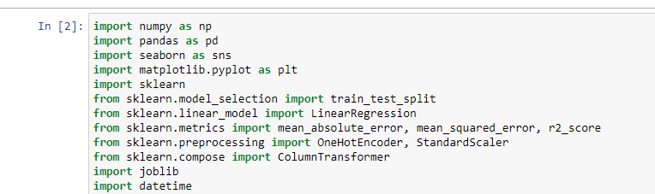
Library which are import for your tasks

Slide 5
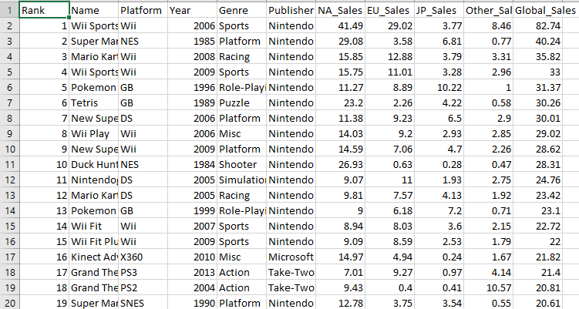
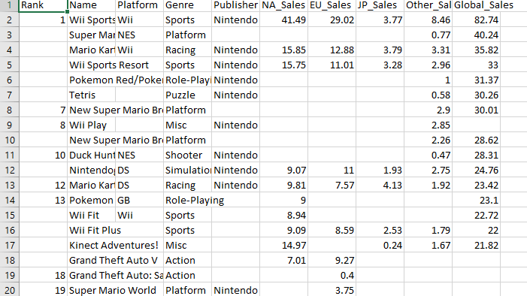
Descriptive of Video Game Sales
Firstly in your data part we collecting your historical data and randomly doing the task like deleting and updating in that and performing many more task.
Raw Data
Updating the data

Slide 6
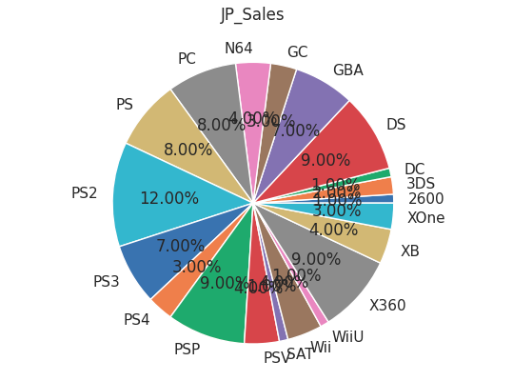
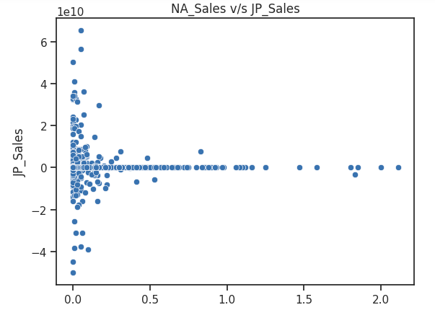
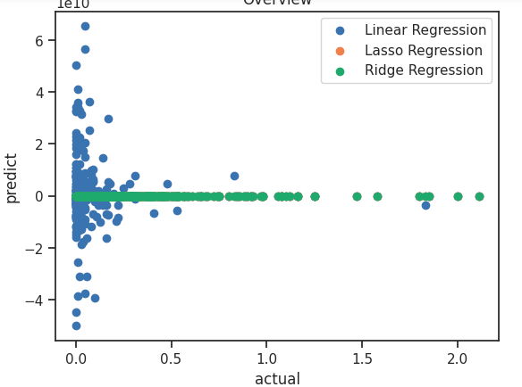
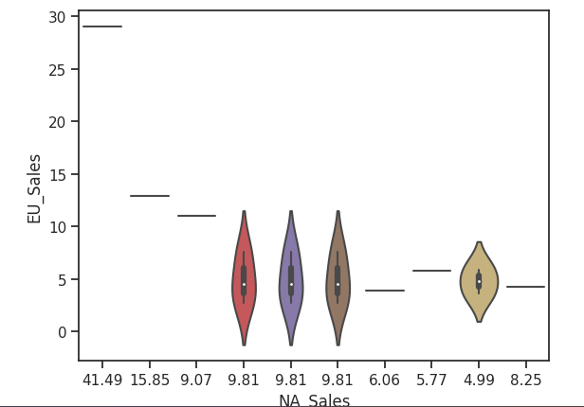
While plotting
The Graph it’s helps to visualize the sales which are been executed in global market

Slide 7
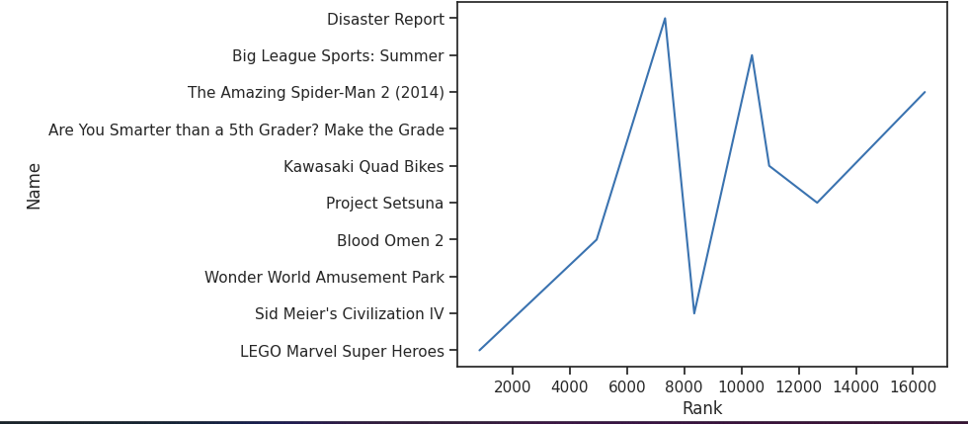
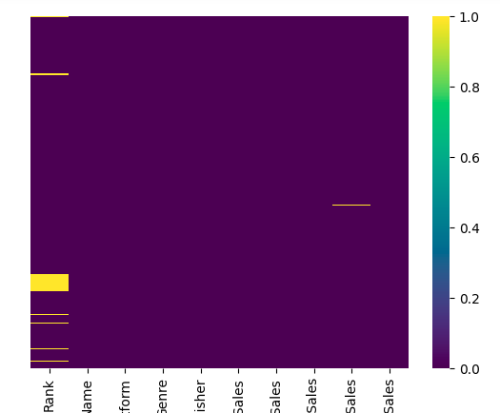
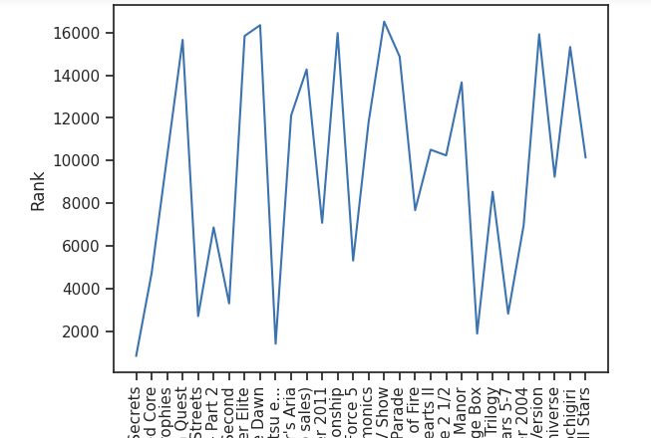
The line plot is most easy to under stand your market performance which are been placed. Then the foundation get to under stand how he placed their market values in their global sales.

Slide 8
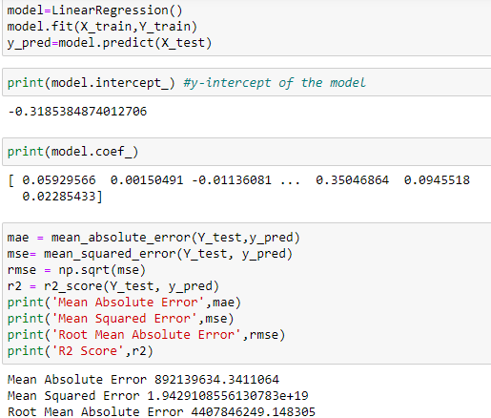
Using Mathematical Tasks in ML
Basically we use many mathematical task in your model like we have Liner regression which are give the numerical factors which are perform by source.
MAE(Mean Absolute Error)
MSE(Mean Square Error)
RMSE(Root mean Absolute Error)

